Slide 1
Battery Management System (BMS) Simulation
Monitoring Battery Voltage, Temperature, Charging, and Discharging Conditions for Efficient Battery Performance and Safety
Submitted By:
Name :Boge Rupa sri
ID:6397

Slide 2
Abstract
A Battery Management System (BMS) is an essential component of electric vehicles and energy storage systems. It continuously monitors battery voltage, current, temperature, State of Charge (SOC), and charging/discharging conditions to ensure safe and efficient battery operation. Improper battery management can lead to overheating, reduced battery life, and safety hazards. This project develops a MATLAB/Simulink-based BMS simulation model to monitor battery parameters and protect the battery from overcharging, deep discharge, and excessive temperature conditions. The simulation helps improve battery performance, reliability, efficiency, and operational safety.

Slide 3
Introduction
The battery is the most critical and expensive component in an electric vehicle. Efficient battery management is necessary to maximize battery life and ensure safe operation. A Battery Management System acts as the "brain" of the battery pack by continuously monitoring and controlling battery conditions. It measures voltage, current, temperature, and charging status while protecting the battery from abnormal operating conditions. BMS technology plays a crucial role in electric vehicles, renewable energy systems, and portable electronic devices.

Slide 4
Objectives:
Monitor battery voltage and current.
Monitor battery temperature.
Prevent overcharging and deep discharge.
Improve battery safety and performance.
Analyze charging and discharging behavior.
Estimate State of Charge (SOC).
Theory
The Battery Management System continuously collects data from sensors placed throughout the battery pack. The collected information is analyzed to determine battery health and operating conditions. If abnormal conditions such as high temperature or overvoltage occur, the BMS activates protection mechanisms to prevent battery damage and ensure safe operation.

Slide 5
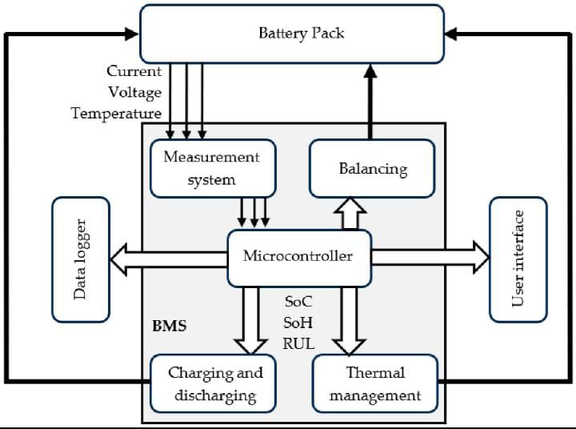
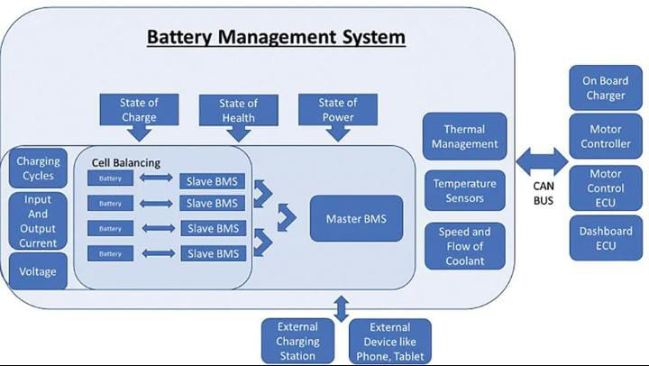
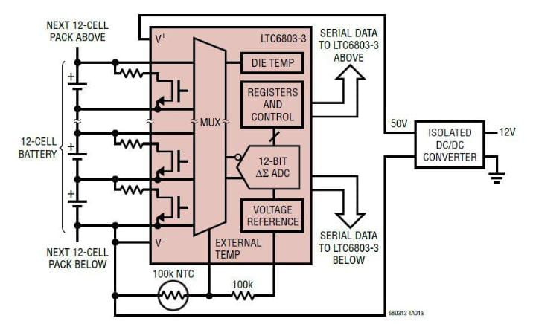
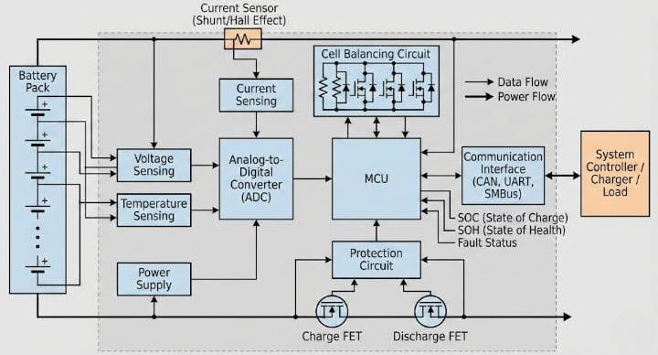
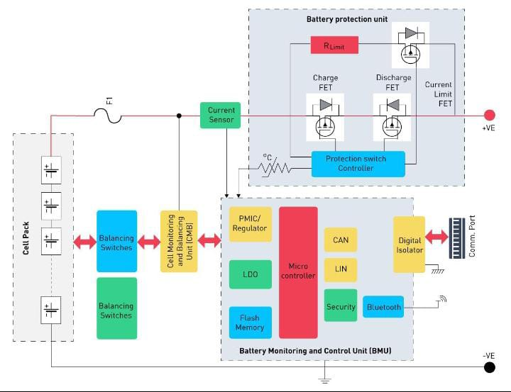
BMS Architecture
Battery Pack.
Voltage Sensor.
Current Sensor.
Temperature Sensor.
BMS Controller.
Protection Circuit.
Communication Module.
Charger Interface.

Slide 6
Working Principle of BMS
Step 1:Measure battery voltage.
Step 2:Measure battery current.
Step 3:Monitor battery temperature.
Step 4:Estimate State of Charge (SOC).
Step 5:Detect fault conditions.
Step 6:Control charging and discharging.
Step 7:Generate warning signals if limits are exceeded.
Step 8:Protect battery from damage.

Slide 7
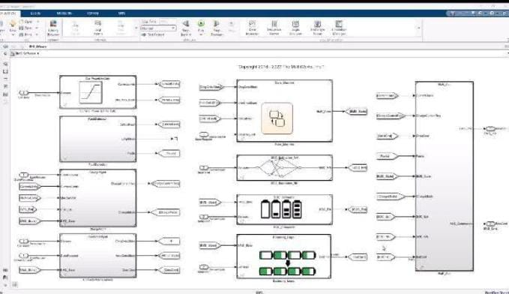
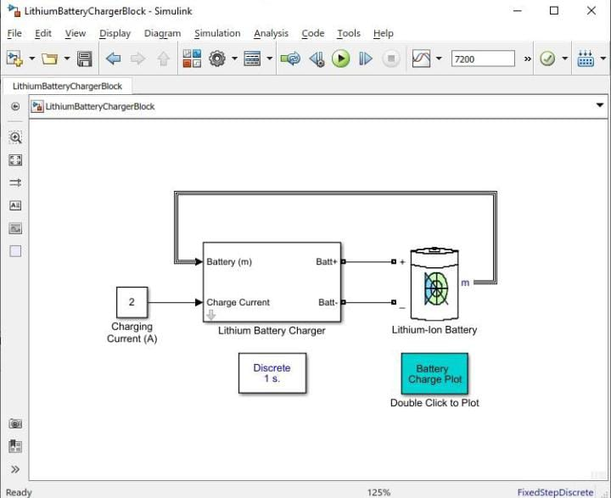
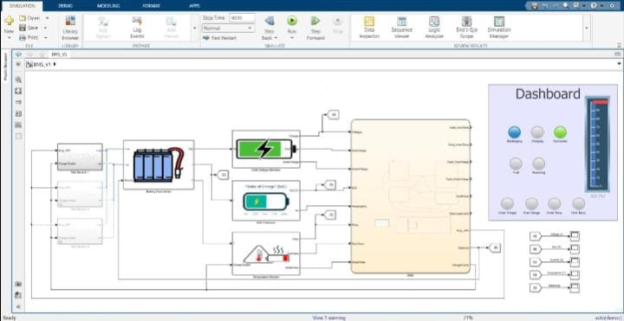
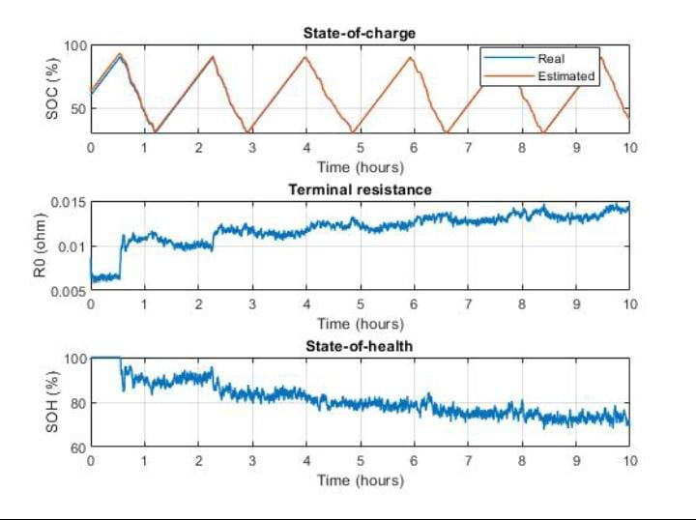
MATLAB/Simulink BMS Model

Slide 8
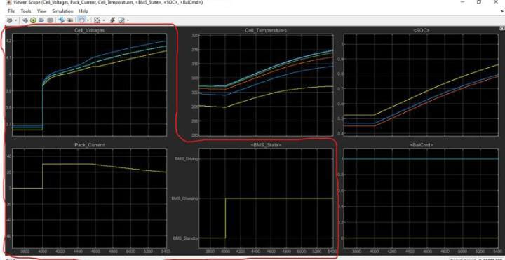
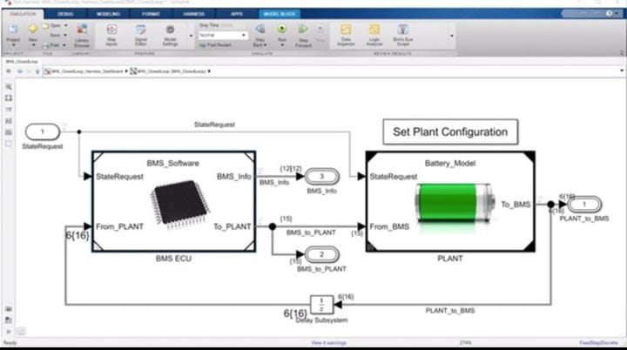
The simulation model consists of:
Battery Block
Voltage Sensor
Current Sensor
Temperature Sensor
SOC Estimator
Protection Logic
Charging Circuit
Monitoring Scopes

Slide 9
Methodology (Step-by-Step Process)
Study Battery Management System operation.
Create battery model in MATLAB/Simulink.
Add voltage monitoring circuit.
Add temperature sensing module.
Configure charging and discharging conditions.
Implement protection logic.
Simulate various operating conditions.
Observe voltage, current, SOC, and temperature.
Analyze results.
Evaluate battery safety and performance

Slide 10
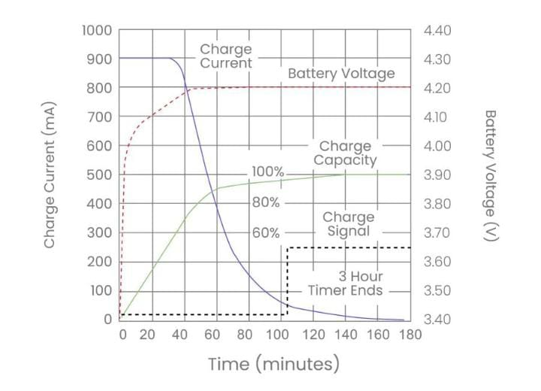
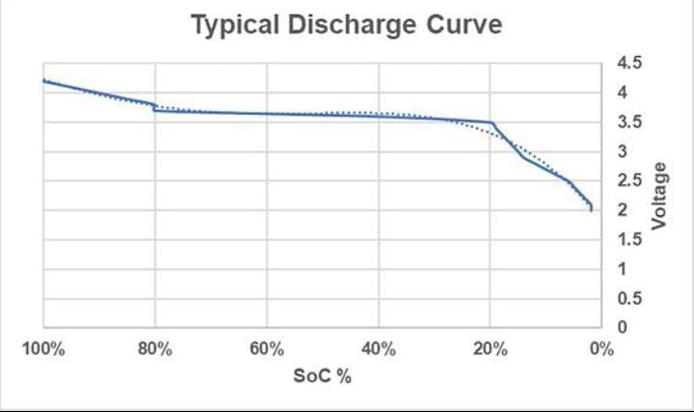
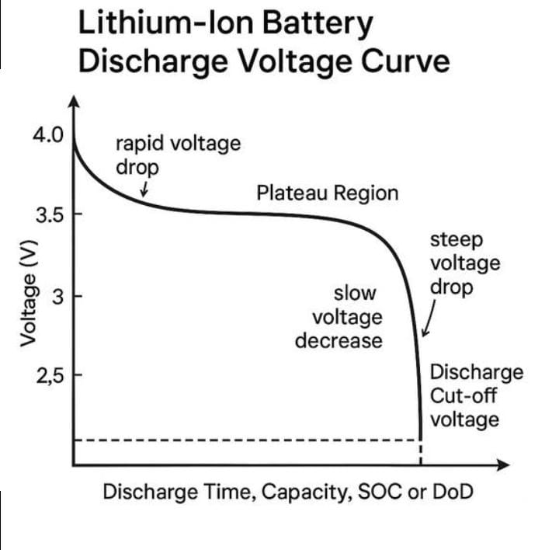
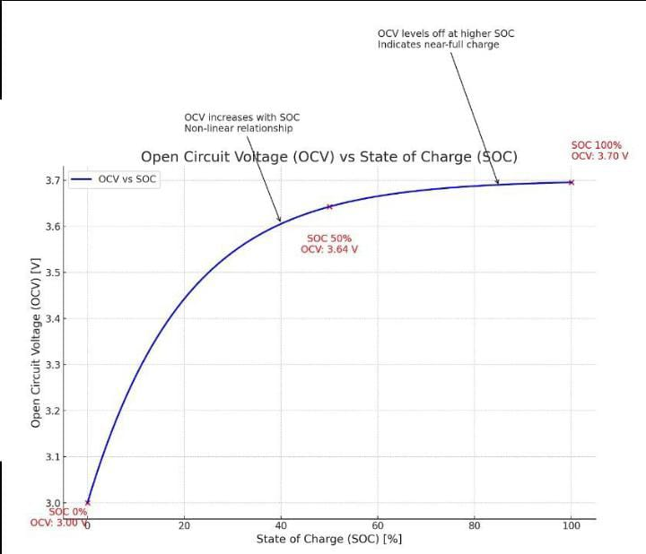
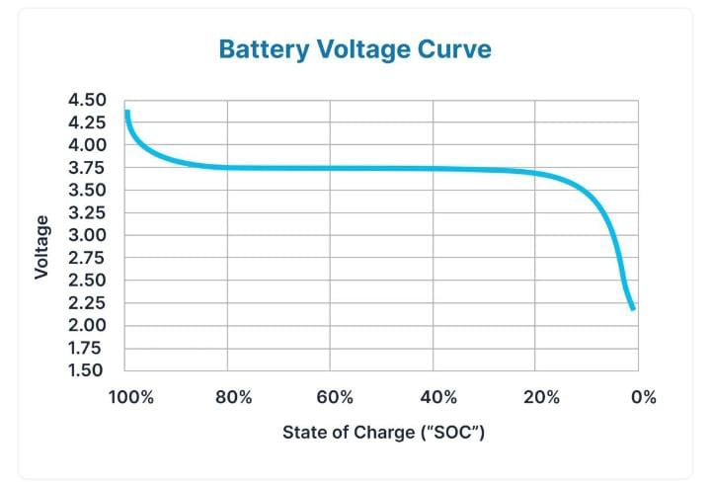
Charging and Discharging Analysis

Slide 11
Results and Performance Analysis
Observed Parameters:
Battery Voltage
Battery Current
Battery Temperature
State of Charge (SOC).
Charging Efficiency
Discharging Rate
Results:
The simulation shows that the BMS successfully monitors battery parameters and protects the battery from unsafe operating conditions. The voltage remains within safe limits, temperature is controlled, and charging/discharging processes are optimized to improve battery lifespan.

Slide 12
Advantages & Applications
Advantages:
Improved battery safety.
Increased battery lifespan.
Prevents overcharging.
Prevents deep discharge.
Temperature protection.
Improved energy efficiency.
Real-time battery monitoring.
Applications.
Electric Vehicles (EVs)
Solar Energy Storage Systems
UPS Systems
Electric Bicycles
Portable Electronics
Industrial Battery Banks

Slide 13
Conclusion & References
Conclusion:
The Battery Management System is essential for ensuring safe and efficient battery operation. Through continuous monitoring of voltage, current, temperature, and State of Charge, the BMS protects the battery from abnormal conditions and extends its lifespan. MATLAB/Simulink simulation demonstrates effective monitoring and control of charging and discharging processes, making the system highly suitable for electric vehicle and energy storage applications.
References: MATLAB & Simulink Documentation.
Battery Management Systems for Electric Vehicles.
IEEE Research Papers on BMS.
Lithium-Ion Battery Management Literature.
Electric Vehicle Battery Technology Books

